Slide 1
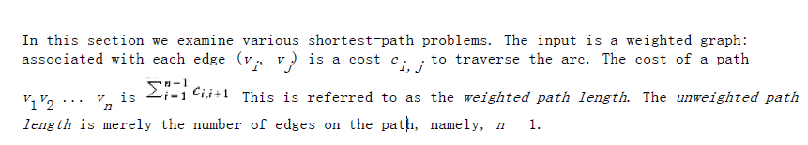
Shortest-Path Algorithms

Slide 2
Dijkstra’s Algorithm
The general method to solve the single-source shortest-path problem is known as Dijkstra’s algorithm.
This thirty-year-old solution is a prime example of a greedy algorithm.
Greedy algorithms generally solve a problem in stages by doing what appears to be the best thing at each stage.

Slide 3
SINGLE-SOURCE SHORTEST-PATH PROBLEM:
Given as input a weighted graph, G = (V, E), and a distinguished vertex, s , find the shortest
weighted path from s to every other vertex in G.

Slide 4
Unweighted Shortest Paths
Figure 9.10 shows an unweighted graph, G. Using some vertex, s, which is an input parameter, we would like to find the shortest path from s to all other vertices.
We are only interested in the number of edges contained on the path, so there are no weights on the edges. This is clearly a special case of the weighted shortest-path problem, since we could assign all edges a weight of 1.
For now, suppose we are interested only in the length of the shortest paths, not in the actual paths themselves. Keeping track of the actual paths will turn out to be a matter of simple bookkeeping.

Slide 5
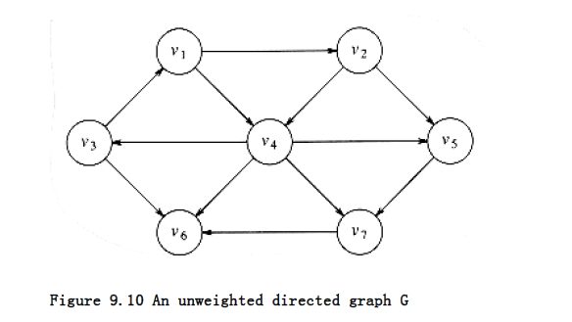

Slide 6
Dijkstra’s algorithm proceeds in stages, just like the unweighted shortest-path algorithm.
At each stage, Dijkstra’s algorithm selects a vertex, v, which has the smallest dv among all the unknown vertices and declares that the shortest path from s to v is known.
The remainder of a stage consists of updating the values of dw.

Slide 7
In the unweighted case, we set dw = dv + 1 if dw = ∞.
Thus, we essentially lowered the value of dw if vertex v offered a shorter path. If we apply the same logic to the weighted case, then we should set dw = dv +cv,w if this new value for dw would be an improvement.
Put simply, the algorithm decides whether or not it is a good idea to use v on the path to w.
The original cost, dw, is the cost without using v; the cost calculated above is the cheapest path using v (and only known vertices).

Slide 8
The graph in Figure 9.20 is our example. Figure 9.21 represents the initial configuration,
assuming that the start node, s, is v1. The first vertex selected is v1, with path length 0.
This vertex is marked known. Now that v1 is known, some entries need to be adjusted.
The vertices adjacent to v1 are v2 and v4. Both these vertices get their entries adjusted, as indicated in Figure 9.22.
Next, v4 is selected and marked known. Vertices v3, v5, v6, and v7 are adjacent, and it turns out that all require adjusting, as shown in Figure 9.23.
Next, v2 is selected. v4 is adjacent but already known, so no work is performed on it.
v5 is adjacent but not adjusted, because the cost of going through v2 is 2 + 10 = 12 and a path of length 3 is already known.
Figure 9.24 shows the table after these vertices are selected.

Slide 9
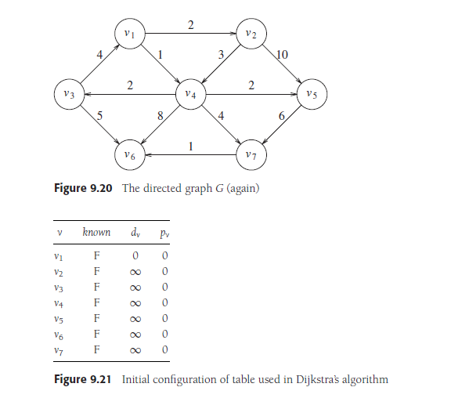

Slide 10
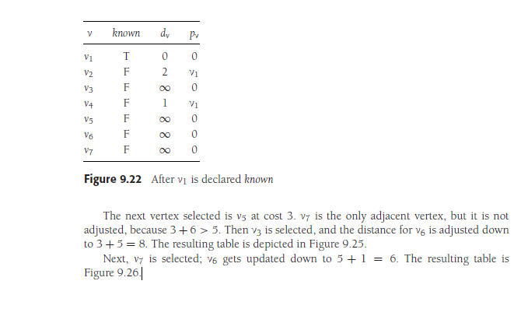

Slide 11
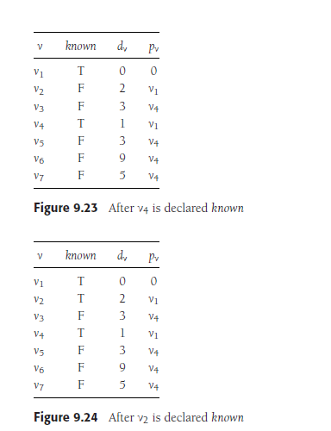

Slide 12
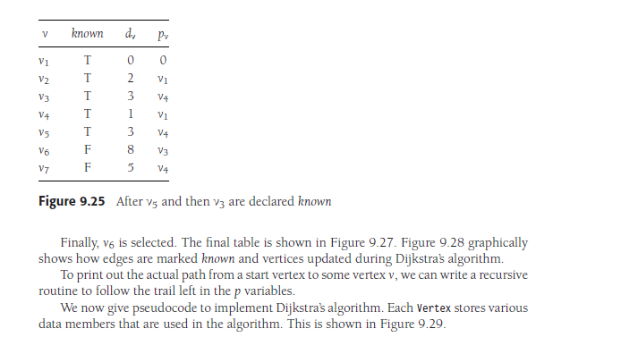

Slide 13
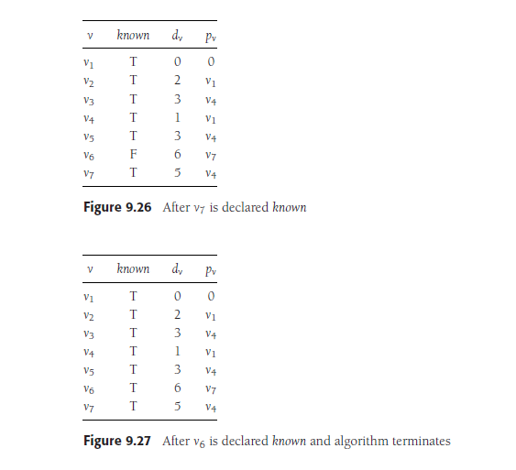

Slide 14
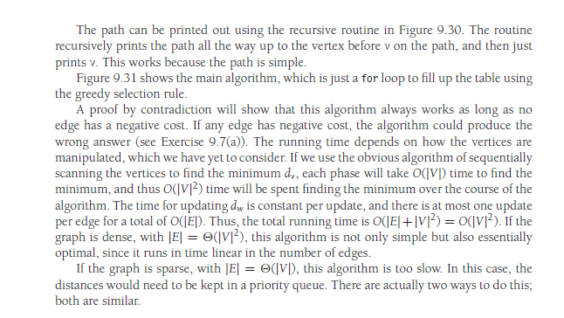

Slide 15
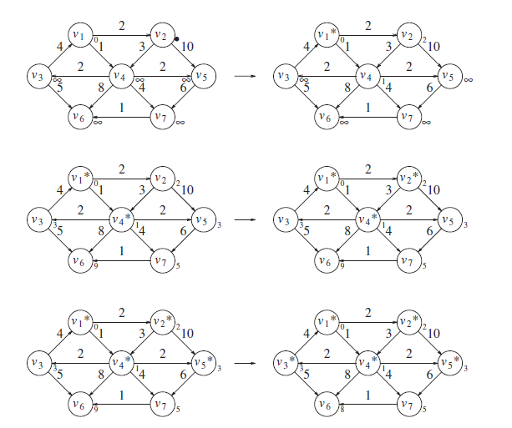

Slide 16
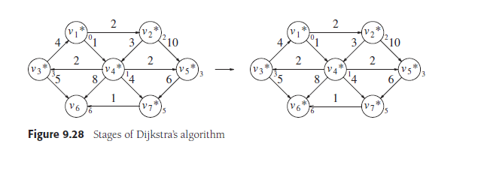

Slide 17
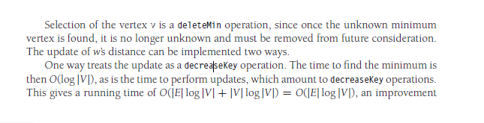
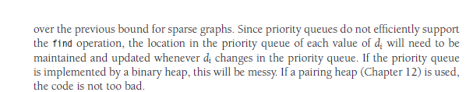

Slide 18
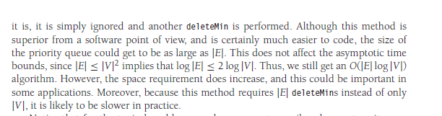

Slide 19
void
unweighted( TABLE T ) /* assume T is initialized (Fig 9.30) */
{
QUEUE Q;
vertex v, w;
Q = create_queue( NUM_VERTEX ); make_null( Q );
/* enqueue the start vertex s, determined elsewhere */
enqueue( s, Q );
while( !is empty( Q ) )
{
v = dequeue( Q );

Slide 20
T[v].known = TRUE; /* not really needed anymore */
for each w adjacent to v
if( T[w].dist = INT_MAX )
{
T[w].dist = T[v].dist + 1;
T[w].path = v;
enqueue( w, Q );
}
}
dispose_queue( Q ); /* free the memory */
}

Slide 21
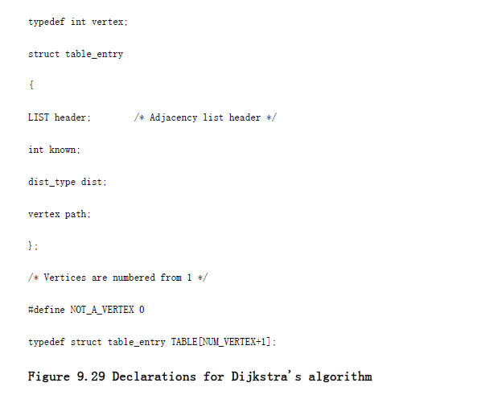

Slide 22
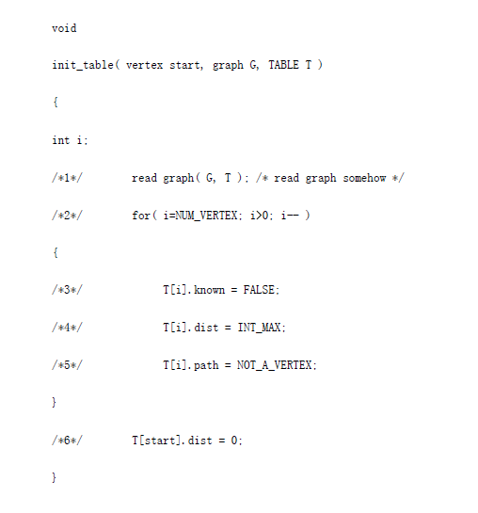

Slide 23
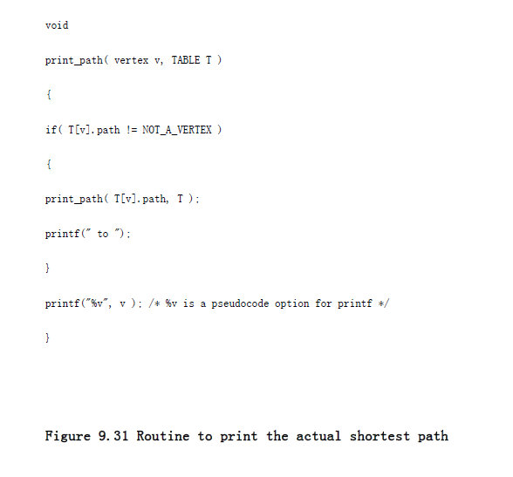

Slide 24
